Slide 1

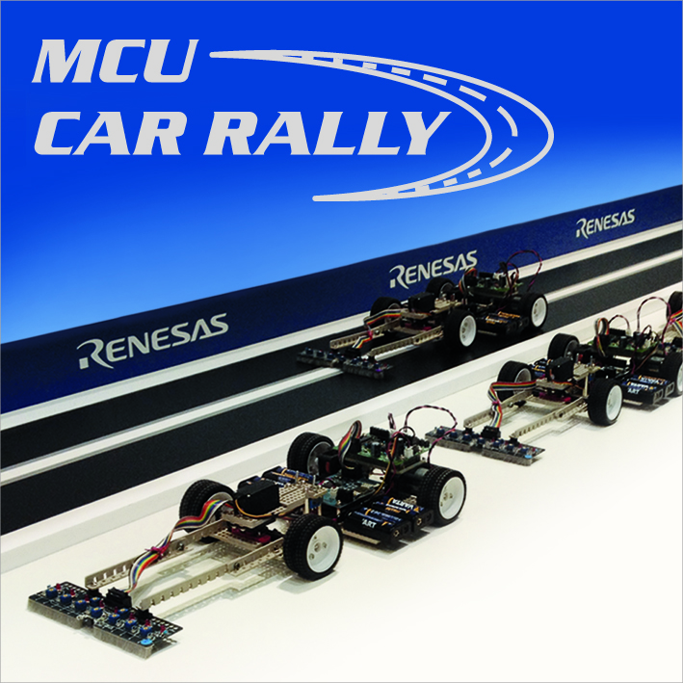
Renesas MCU Car Rally 2018
Faculty of Computing, Engineering and Science
University of South Wales – 2017/18
MEng Group Project
Weekly Report
Students:
13013521 Thomas Brown – MEng Electrical and Electronic Engineering
15021106 Kayin Templar– MEng Electrical and Electronic Engineering
14031329 Miguel Santos – MEng Computer Systems Engineering
Lecturer:
Prof Gouping Liu

Slide 2
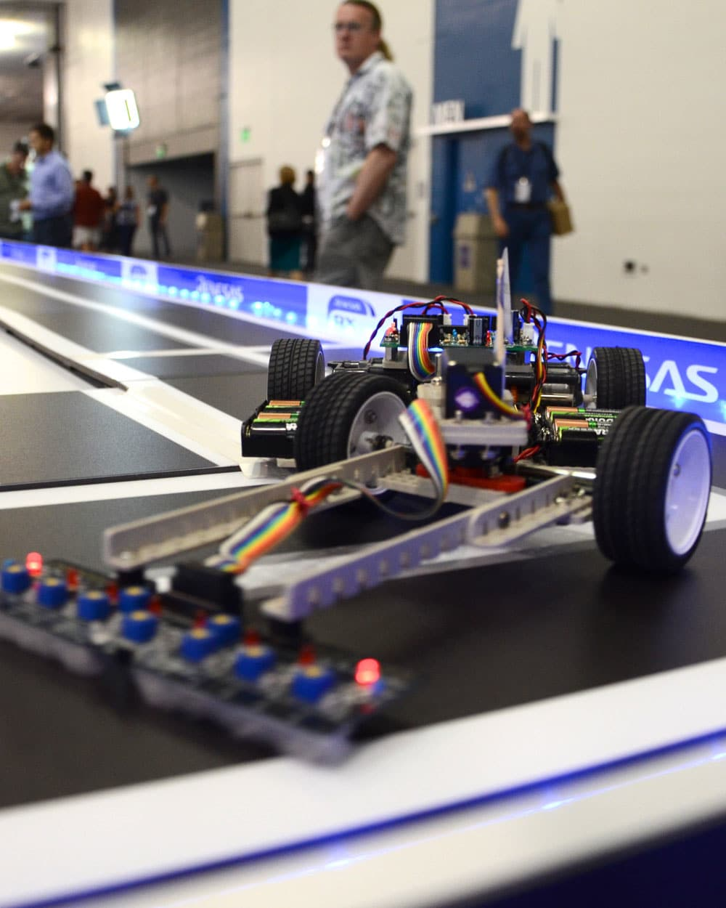
Week 6 – 25 October 2017
This week’s developments
Next week…
MEng Group Project – Renesas MCU Car Rally 2017/18

Slide 3
This week’s developments
This week, we worked on:
The DC motor control using PWM
Servo control also using PWM
Graphical application on Microsoft Windows
Wireless communication manager
MEng Group Project – Renesas MCU Car Rally 2017/18

Slide 4
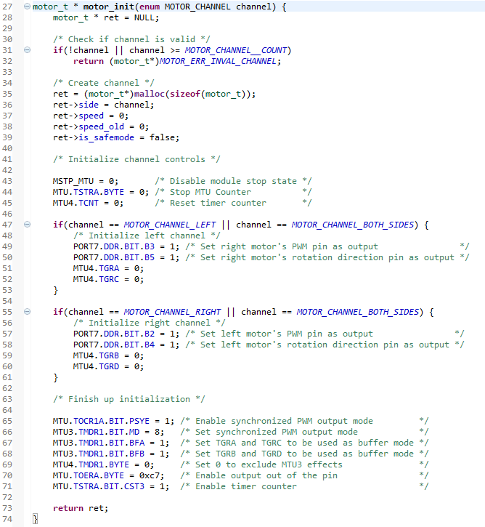
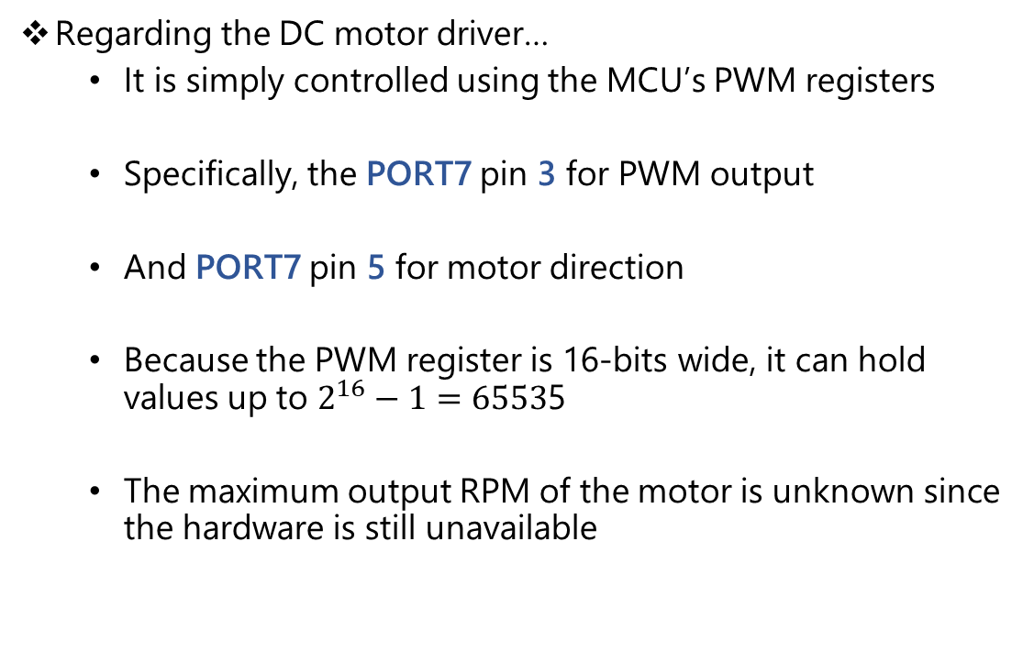
This week’s developments - detailed
Regarding the DC motor driver…
It is simply controlled using the MCU’s PWM registers
Specifically, the PORT7 pin 3 for PWM output
And PORT7 pin 5 for motor direction
Because the PWM register is 16-bits wide, it can hold values up to $2^{16}−1=6553$5
The maximum output RPM of the motor is unknown since the hardware is still unavailable
MEng Group Project – Renesas MCU Car Rally 2017/18

Slide 5
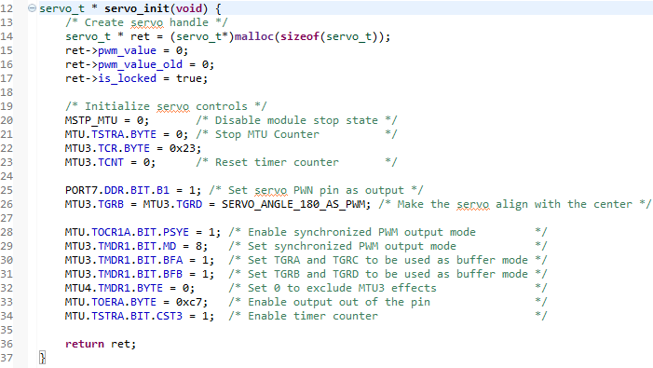
This week’s developments - detailed
Regarding the servo driver…
Similarly, the servo uses the PORT7 pin 1 for output
MEng Group Project – Renesas MCU Car Rally 2017/18

Slide 6
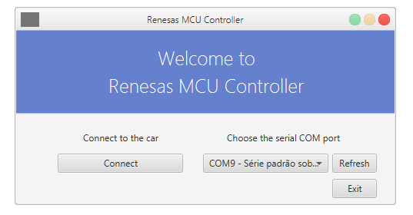
This week’s developments - detailed
Regarding the graphical application on Windows…
The reason:
We need to debug the software effectively, including the sensors’ values
These samples would be plotted across time in this graphical application
In addition, value tweaking is a desired feature that could help us develop the project at a much faster rate by finding and optimizing any hidden parameter
MEng Group Project – Renesas MCU Car Rally 2017/18

Slide 7
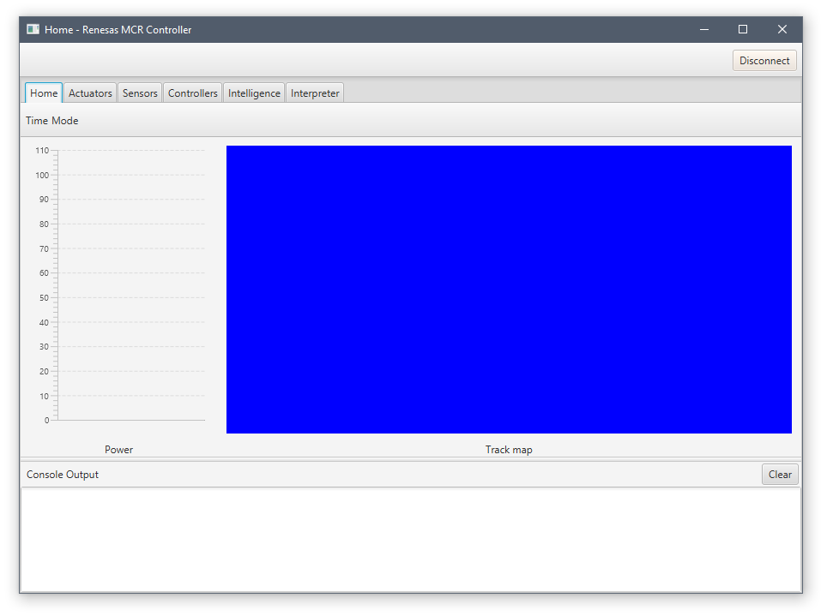
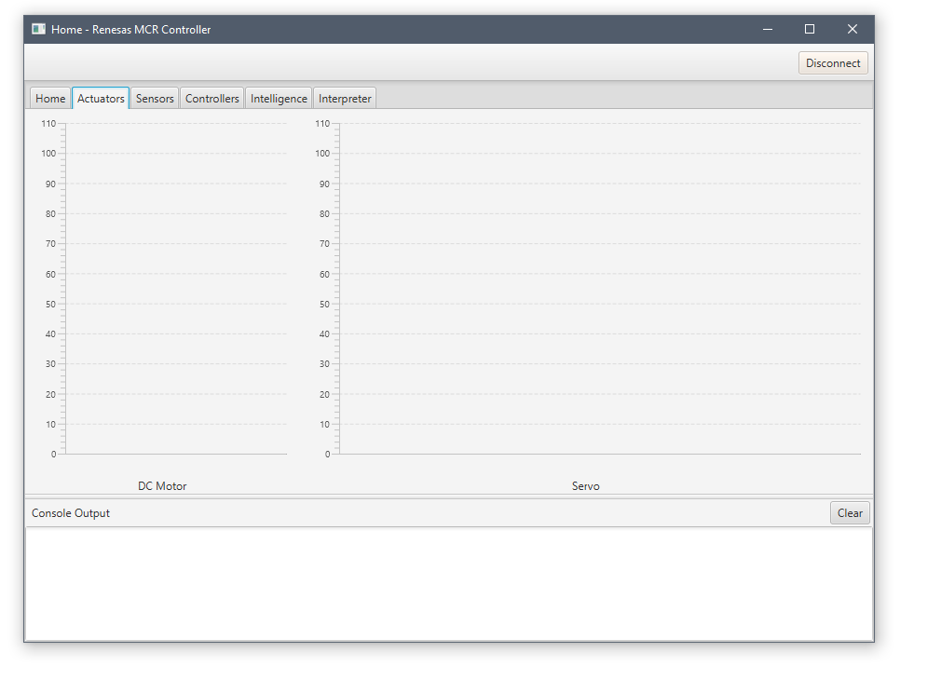
This week’s developments - detailed
MEng Group Project – Renesas MCU Car Rally 2017/18

Slide 8
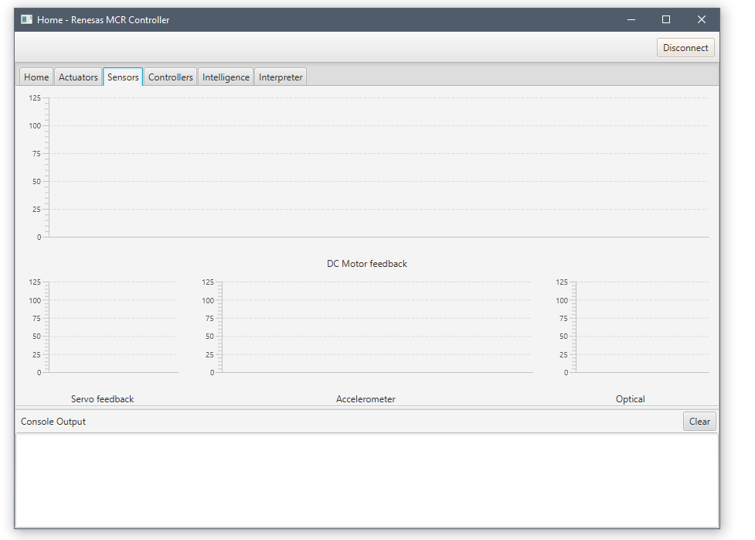
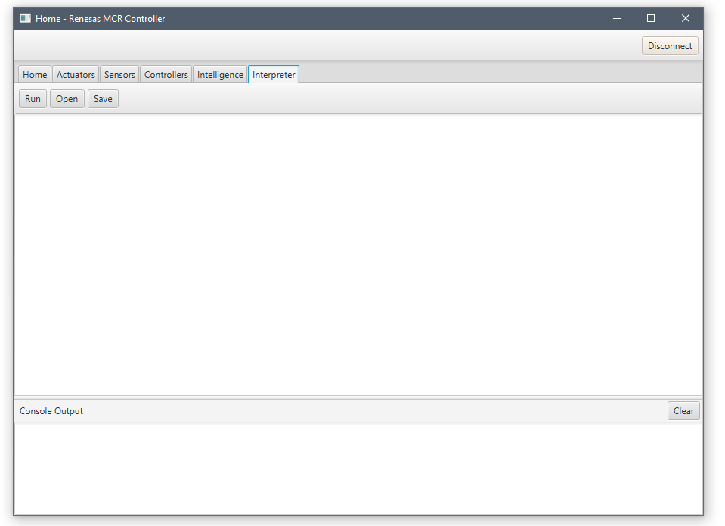
This week’s developments - detailed
MEng Group Project – Renesas MCU Car Rally 2017/18

Slide 9
This week’s developments - detailed
Regarding wireless communication manager…
Why do we need a communication manager:
It is known that all I/O is now being routed through the Bluetooth module
And due to the fact that we are transferring complex data (multiple sensors, debug messages, commands, etc.), we needed to develop a simple communication protocol to abstract UART a bit further
MEng Group Project – Renesas MCU Car Rally 2017/18

Slide 10
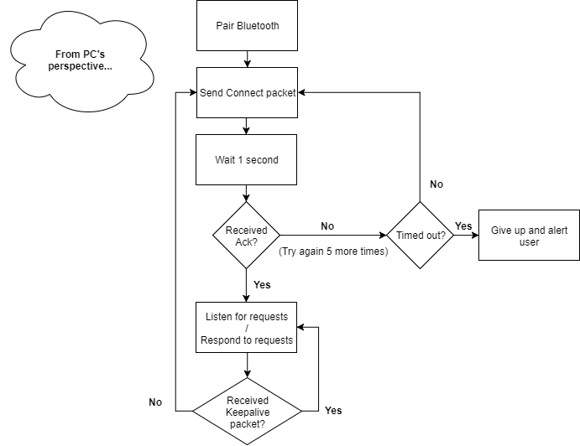
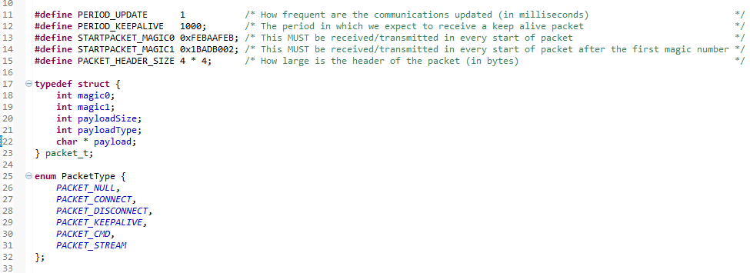
This week’s developments - detailed
Regarding wireless communication manager…
The first thing this protocol needs is synchronisation and a session to be established between the two hosts (PC<->Car / Android<->Car)
We can see how easy this can be done with the structure below
MEng Group Project – Renesas MCU Car Rally 2017/18

Slide 11
Next week…
This coming week will be dedicated to:
Assembling and soldering the car
Discovering the best battery using the treadmill
Completing/improving the theory for the PID controller
Completing the wireless communication manager
Finishing up the Windows application
Implementing drivers for the optical sensors
Beginning the implementation of the PID controller in software
MEng Group Project – Renesas MCU Car Rally 2017/18

Slide 12
Questions?

